Slide 1
The Origins of Settlement in Ireland
Chapter
20
Learning outcomes: 3.4

Slide 2
At the end of this chapter, you will be able to:
20.1 Describe the different types of settlement in Ireland through time.
20.2 Describe and explain the different types of rural settlement patterns.
20.3 Explain the factors affecting the location of nucleated settlement.
20.4 Describe what is meant by ‘functions of nucleated settlement’.

Slide 3
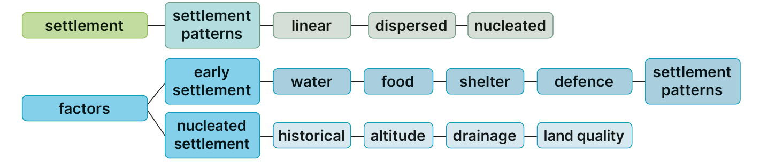
Keyword connections

Slide 4
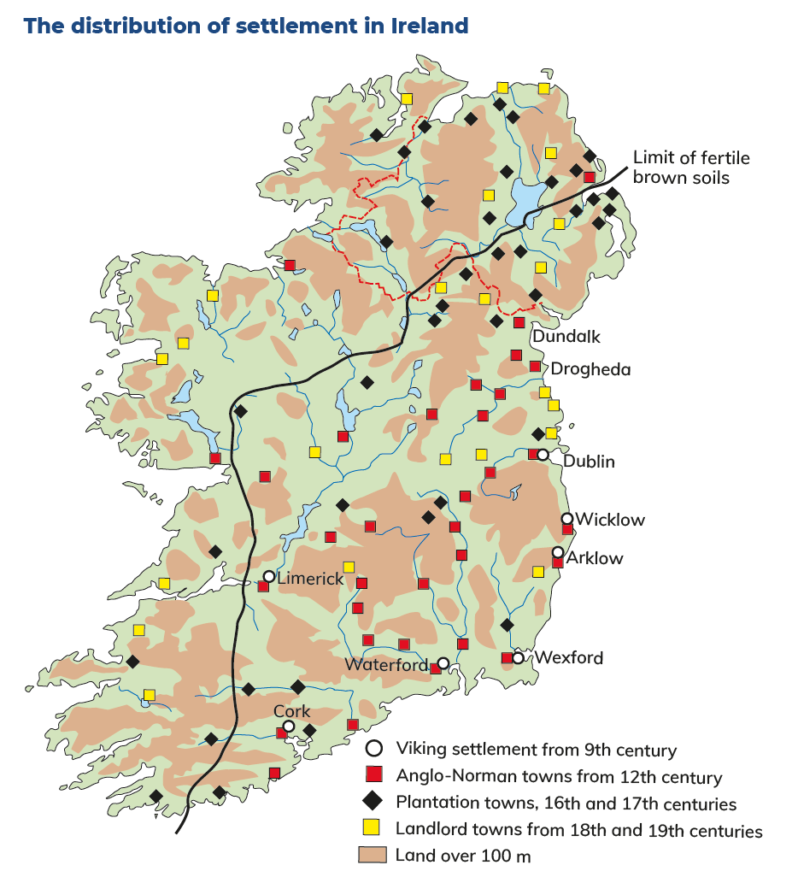

Slide 5
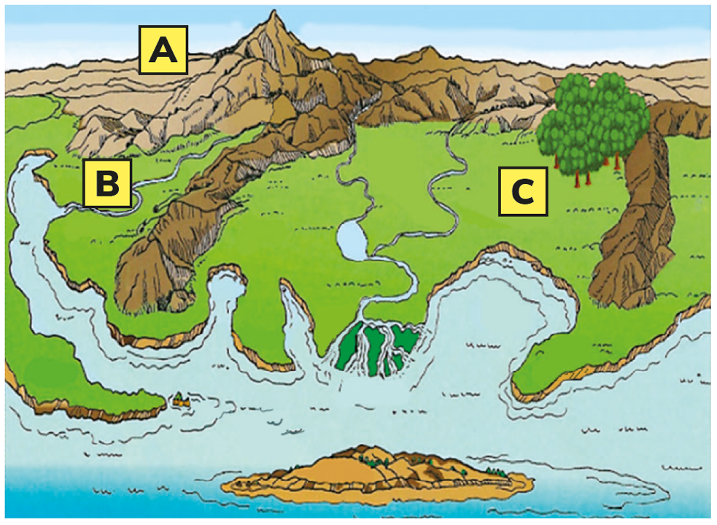
20.1 Describe the different types of settlement in Ireland through time.
The image opposite shows an area along the coast similar to the area that Ireland’s first settlers arrived at long ago.
If you were one of the first settlers in the area shown, would you choose to settle at site A or B or C?
Explain in detail why you would choose to settle at this site.

Slide 6

Factors affecting early settlement in Ireland
Water: Early settlers needed access to fresh water for drinking, cooking and washing.
Food: Early settlers were hunters and gatherers. They needed a source of animals and nuts and berries.
Shelter: Early settlers needed materials that they could use to build a shelter.
Defence: When the first settlers arrived here they didn’t know they were the first settlers. They needed to be able to protect themselves from attack.
Communications: Settlers needed to be able to move from place-to-place in search of the resources they needed.
Most early settlement in Ireland located near the banks of rivers, sometimes on a slightly elevated (upland) site, near a forest. Rivers provided fish for food and water for drinking. The forest provided nuts and berries and the materials to make a shelter. Forests were also home to animals such as wild boar, which were a source of meat and skins for clothing. The river also provided a communication route – early settlers could travel up-river using their dug-out canoes. And in case of danger, the river provided a means of escape.
20.1 Describe the different types of settlement in Ireland through time.
Factors affecting early settlement in Ireland
Water: Early settlers needed access to fresh water for drinking, cooking and washing.
Food: Early settlers were hunters and gatherers. They needed a source of animals and nuts and berries.
Shelter: Early settlers needed materials that they could use to build a shelter.
Defence: When the first settlers arrived here they didn’t know they were the first settlers. They needed to be able to protect themselves from attack.
Communications: Settlers needed to be able to move from place-to-place in search of the resources they needed.

Slide 7
20.1 Describe the different types of settlement in Ireland through time.
Factors affecting early settlement in Ireland
The first settlers to arrive in Ireland were hunter-gatherers.
They needed access to rivers and forests.
Site A has no access to a river, nor to a forest.
Site B has access to a river but not to a forest.
Site C has access to a river and the resources of the nearby forest.
Early settlers would choose Site C.

Slide 8
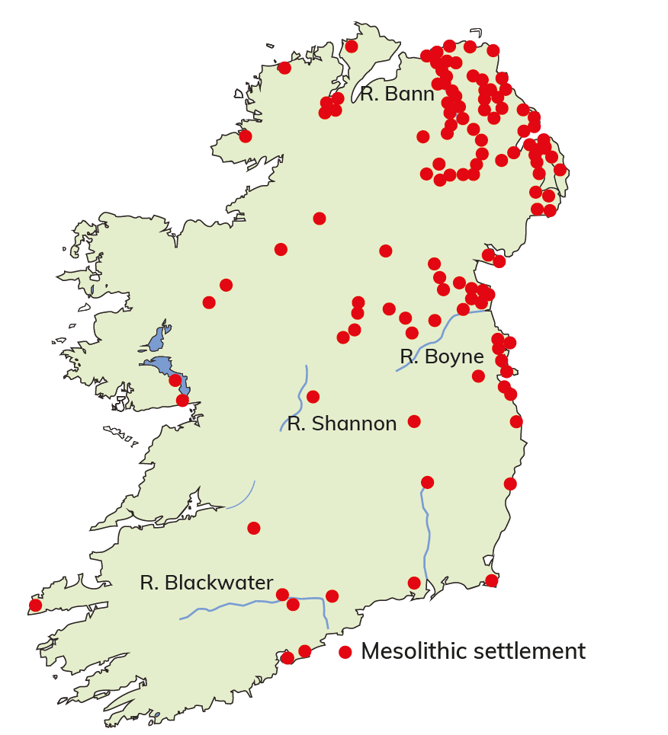
20.1 Describe the different types of settlement in Ireland through time.
Mesolithic settlement – from 7,000 BC
The earliest evidence for permanent settlement in Ireland is in Mount Sandel.
The first settlers arrived during the Mesolithic period – Middle Stone Age – and survived by hunting animals and gathering nuts and berries.
We think they arrived in Ireland by crossing land bridges connected to Britain. As the sea level rose, some crossed in dug-out canoes.

Slide 9
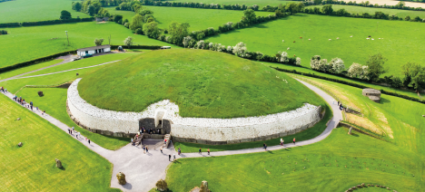
20.1 Describe the different types of settlement in Ireland through time.
Neolithic settlement – from 5000 BCE
Neolithic settlers came to Ireland around 5000 BCE.
They were the first settlers to farm the land.
They brought pigs, cattle, sheep and wheat.
Ireland was covered in forest, so they sailed up rivers to find suitable locations for settlement.
Most Neolithic settlement is found near the banks of rivers and lakes.
Neolithic settlers had only wooden ploughs,
So they also settled in hilly locations, where the soil was lighter and easier to dig.
We know where Neolithic people lived by looking at where they built their tombs.
There are four types of tomb: court cairns, passage graves, portal dolmens and wedge tombs.

Slide 10
20.1 Describe the different types of settlement in Ireland through time.
Bronze Age – from 2,000 BC
There is also little evidence of Bronze Age houses in Ireland.
Evidence where stone circles and fulacht fia (or fiadh) are located. Stone circles were worship sites.
Fulacht fia were stone-lined pits filled with water in which food was cooked.

Slide 11
20.1 Describe the different types of settlement in Ireland through time.
Complete the Exam Expert section on page 242 of your Textbook.

Slide 12
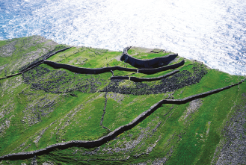
20.1 Describe the different types of settlement in Ireland through time.
The Celtic Iron Age – from 500 BC
The Celts arrived in Ireland during the Iron Age from around 500 BCE.
The Celts built forts, often called ‘dun’.
Inside a fort was houses, stores, halls and other buildings.
Examples include Tara Hill, Co. Meath, and Emain Macha, Co. Armagh.
Place names with ‘dun’, ‘lios’, ‘rath’ and ‘cashel’ tell us that the origin of a settlement was during the Iron Age.

Slide 13

20.1 Describe the different types of settlement in Ireland through time.
1. List five factors that affected the location of early settlement in Ireland.
2. How do we know where Neolithic people lived in Ireland?
3. What is a ringfort?
4. What place names tell us the origin of a settlement was in the Iron Age?
5. How is evidence for early settlement shown on an OS Discovery Series map?

Slide 14
20.1 Describe the different types of settlement in Ireland through time.
Higher-order questions 1
1. What did Neolithic houses look like? Research your History textbook to find out.
2. Where early settlers the only ones to locate near rivers?
3. Is it possible that later settlers used the same settlement locations as previous settlers?

Slide 15
20.1 Describe the different types of settlement in Ireland through time.
Go to Section 20.1 on page 106 of your Skills Book.

Slide 16
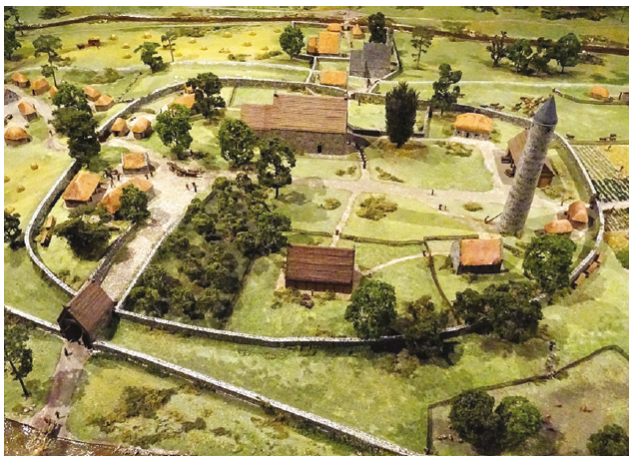
20.1 Describe the different types of settlement in Ireland through time.
Early Christian settlement – from 500 CE
Christianity spread in Ireland after St Patrick came here in 432 CE.
Communities of monks built monasteries with churches, infirmaries, scriptoriums and round towers.
They were enclosed by a circular wall to protect them from attack.
The monks had to grow their own food.
Many monasteries were built in low-lying areas with fertile brown soils.
The monks looked for peaceful locations, so monasteries tended to be located in remote areas such as Glendalough, Co. Wicklow, and Clonmacnoise, Co. Offaly.

Slide 17
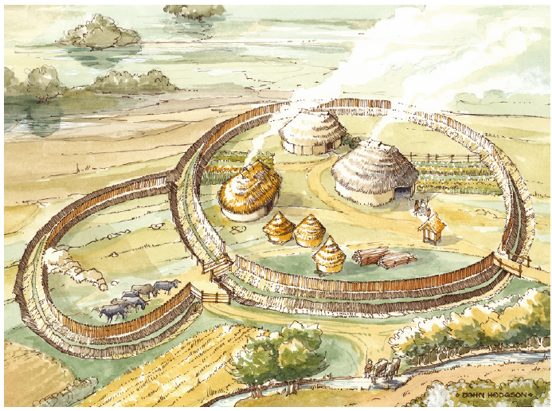
20.1 Describe the different types of settlement in Ireland through time.
Ringforts (or raths)
Circular enclosures protected by a ditch and a circular wooden fence
Date from between the fifth to the tenth century CE
Family farmsteads with houses made of wattle and daub
47,000 recorded ringforts in Ireland
Tended to avoid bogland and land over 335 m
Place names with ‘rath’ indicate early Christian farmsteads, e.g. Rathdowney, Co. Laois.
A reconstruction of a ringfort. Originally commissioned by Cork County Council/NRA. Image copyright © John Hodgson

Slide 18
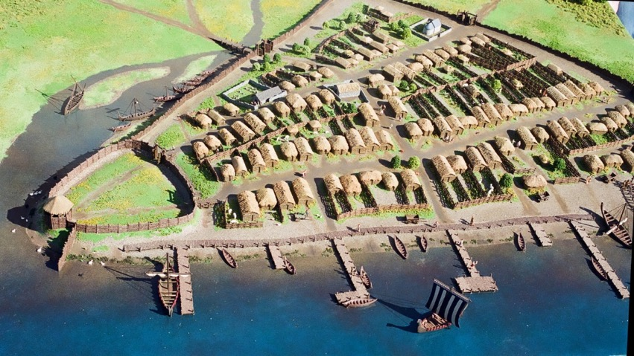
20.1 Describe the different types of settlement in Ireland through time.
Viking settlement – from 800 CE
The Vikings from Scandinavia traded as far as the Mediterranean.
They raided monasteries from the end of the eight century.
Later, they settled along the coast and built Ireland’s first towns.
Ports with two main streets
Most important street was often called ‘High Street’
Contained the marketplace.
The town was surrounded by a wall for defence.
Place names ending in ‘ford’, from the Norse words ‘fjord’, meaning ‘inlet’, and ‘low’, meaning ‘lowland’, indicate Viking settlements.
Image © Crowley Model Makers
Examples of Viking towns include Waterford and Wicklow.

Slide 19
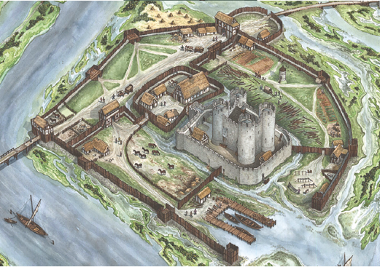
20.1 Describe the different types of settlement in Ireland through time.
Anglo-Norman settlement – from 1169 CE
The Anglo-Normans arrived in Ireland in 1169 CE.
Colonised Leinster, taking over land that had the best soil (brown soil)
Built castles at bridging points on a bend in a river
Rivers provided water for their basic needs and made it easier to defend the castle
Bridging point gave the Anglo-Normans control of routeways across the land.
The castles were attractive locations for markets.
Over time, the most successful markets attracted enough settlers and a town grew up around the castle.
The Normans were Christians and had links with monastic orders such as the Cistercians and Franciscans, who often built monasteries, abbeys and friaries close to their towns.
Image © Uto Hogerzeil

Slide 20

20.1 Describe the different types of settlement in Ireland through time.
Compare the artist’s image of Carlow with the aerial photograph in Fig. 20.10 on page 244 of your Textbook. Note where the town developed.
A reconstruction of the Anglo-Norman castle in Carlow. Image © Uto Hogerzeil

Slide 21

20.1 Describe the different types of settlement in Ireland through time.
1. In what type of location did monks set up their monasteries? Name three characteristics of the sites they chose.
2. Why did Vikings come to Ireland?
3. In what type of location did the Anglo-Normans choose to settle?
4. What building was the focus of Anglo-Norman towns?
5. Why did early settlements have walls surrounding them?

Slide 22
20.1 Describe the different types of settlement in Ireland through time.
Higher-order questions 2
1. Why did the Anglo-Normans come to Ireland? Research this topic in your History book.
2. Why were markets so important to towns?
3. How did the shape of a monastery affect the towns that grew up around them? (Hint: Its walls)

Slide 23
20.1 Describe the different types of settlement in Ireland through time.
Go to Section 20.1 on page 106 of your Skills Book.

Slide 24
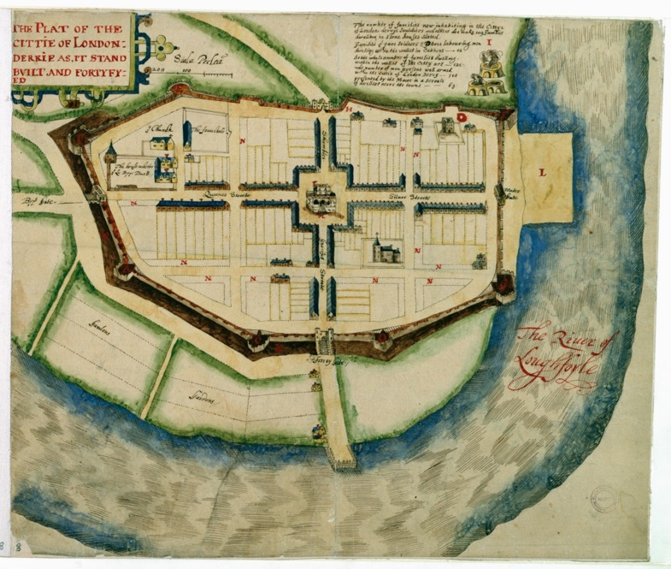
20.1 Describe the different types of settlement in Ireland through time.
Plantation settlement – from the 1560s
The first plantations in Ireland by English settlers failed.
However, the Plantation of Ulster, begun in 1609, was more successful.
Plantation towns were built as market centres, and to provide protection for settlers.
These towns were planned carefully on paper.
This meant they often had straight streets.
In the middle of the plantation town, there was an open space for a market square, called a diamond.
These towns gradually developed into modern towns such as Derry, Coleraine and Raphoe.

Slide 25
20.1 Describe the different types of settlement in Ireland through time.
Landlord towns – from 1703
By the eighteenth century, the descendants of earlier settlers had built up large estates called landlord estates.
Some landlords built towns directly outside their walled properties.
These towns were often a single straight street with a market square in the middle.
On the street, there was also a church, which the landlord would attend on Sundays.
Examples include Birr, Co. Offaly, Strokestown, Co. Roscommon, and Blessington, Co. Wicklow.
A vertical aerial photograph of Strokestown, Co. Roscommon. On the right is the landlord’s house. Running through the middleground is the main street.

Slide 26
20.1 Describe the different types of settlement in Ireland through time.
New towns – Twentieth century
In the 1960s, Ireland’s population began to increase for the first time since the Great Famine.
In Dublin, many people were still living in poor housing.
The government built new towns to provide housing for people.
Ballymun, near Dublin Airport, was built to provide housing for people who were moved from the city centre.
This was later followed by Tallaght, Lucan-Clondalkin and Blanchardstown.
In the 2000s, Adamstown in west Dublin was developed as a new town.

Slide 27
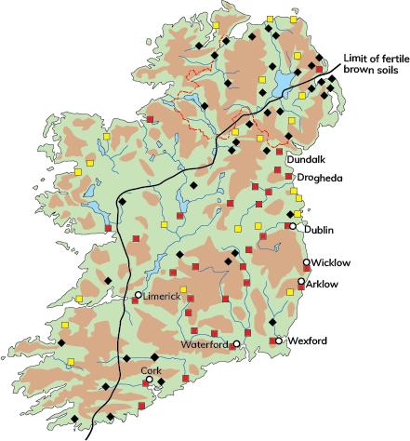
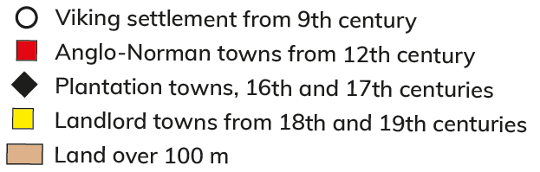
20.1 Describe the different types of settlement in Ireland through time.

Slide 28

20.1 Describe the different types of settlement in Ireland through time.
Look at Figure 20.11 on page 245 of your Textbook. Identify three pieces of evidence on this map that tells you this was a plantation town.
2. Identify three characteristics of a landlord town.
Look at Figure 20.13 on page 246 of your Textbook. What is the connection between Anglo-Norman settlement and soil type?
What is the connection between rivers and the location of towns?
5. Why are there few towns over 100 m?

Slide 29
20.1 Describe the different types of settlement in Ireland through time.
Higher-order questions 3
1. Research the history of plantations in Ireland in your History textbook. Why did the plantations occur?
2. What is the origin of your nearest town?
3. Why are there fewer towns west of the River Shannon?

Slide 30
20.1 Describe the different types of settlement in Ireland through time.
Go to Section 20.1 on page 106 of your Skills Book.

Slide 31
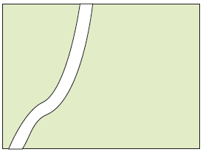
20.2 Describe and explain the different types of rural settlement patterns.
‘Settlement pattern’ is the name given to the shape or appearance that a settlement takes on the landscape.
Absence of settlement
Over a wide area – more than 2 km²
May be due to poor soil quality, poor drainage, high
altitude, lack of access or distance from nucleated
settlements and their services

Slide 32
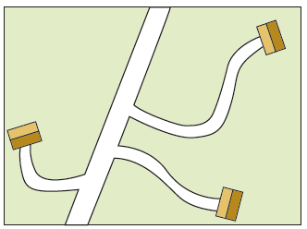
20.2 Describe and explain the different types of rural settlement patterns.
Dispersed settlement pattern
Appears as individual houses, which are often farmsteads
The most common rural settlement pattern
The density of this settlement type depends on soil quality
drainage and aspect
May represent one-off housing

Slide 33
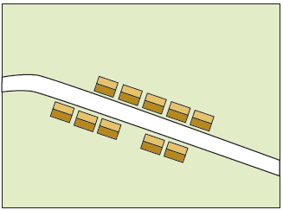
20.2 Describe and explain the different types of rural settlement patterns.
Linear settlement pattern
Appears as houses lined along a road
Provides access to towns
Provides access to underground pipes (e.g. water, gas, sewerage) and cables (e.g. telephone, ESB lines)
Occurs on the edge of towns or leading into smaller
nucleated settlements
May represent bungalow blitz – uncontrolled one-off
housing developments in the 1980s

Slide 34
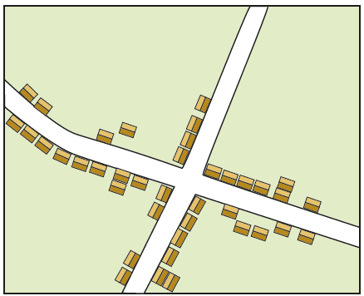
20.2 Describe and explain the different types of rural settlement patterns.
Nucleated settlement pattern
Appears as a cluster of houses or buildings arranged around a crossroads or other road intersection
Includes houses, shops and pubs, with a church and school close by
Businesses located at the crossroads to attract customers using either road
Attracts residents, which in turn attracts services; the provision of more services further attracts more residents

Slide 35
20.2 Describe and explain the different types of rural settlement patterns.
Go to Section 20.2 on page 109 of your Skills Book.

Slide 36
20.3 Explain the factors affecting the location of nucleated settlement.
Altitude
Altitude is the height above sea level.
Mountains and hills more than 200 m above sea level
More exposed to wind, rain and colder temperatures
Less accessible.
As a result, towns and cities are generally found in lowland areas.
Lowland areas are easier to build on and are usually well connected to transport links.

Slide 37
20.3 Explain the factors affecting the location of nucleated settlement.
Land quality
Most settlements developed on areas of well-drained, fertile land.
Anglo-Norman settlers located their settlements on fertile brown soils.
Over time, the local market drove the growth of these settlements.
During the Plantation of Ulster in the seventeenth century, Scottish and English settlers were attracted to the fertile agricultural land of the Lagan Valley, and towns such as Belfast grew as market centres.

Slide 38
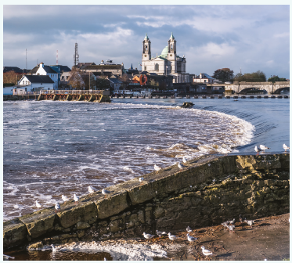
20.3 Explain the factors affecting the location of nucleated settlement.
Drainage
Many Irish settlements are located in well-drained areas that contain rivers or streams.
Rivers were used for water and transport.
Deposits of alluvium along a river’s floodplain produced a fertile soil suitable for farming.
Therefore, many settlements are located a short distance from a river’s floodplain.
Many towns developed at the bridging point of a river. Some towns also developed on dry-point sites – sites near a river but on a hill so that rainwater drained down to the river.
Poorly drained areas contain fewer settlements.

Slide 39
20.3 Explain the factors affecting the location of nucleated settlement.
Go to Section 20.3 on page 110 of your Skills Book.

Slide 40
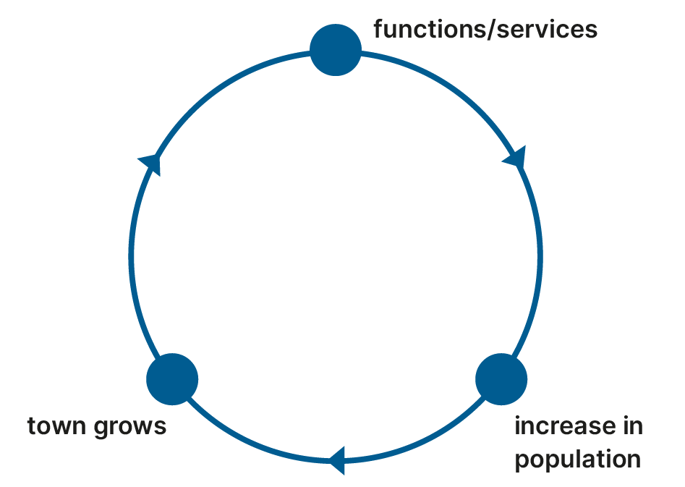
20.4 Describe what is meant by ‘functions of nucleated settlement’.
The functions of a settlement are the services it provides.
Examples of functions includes retail (shops) and residential (housing).
Some nucleated settlements may have had one major function
For example, Anglo-Norman towns started as defence settlements.
Over time, however, most settlements have become multifunctional.
This means they have a range of functions or services they provide to the people of the town and the surrounding area (hinterland).

Slide 41
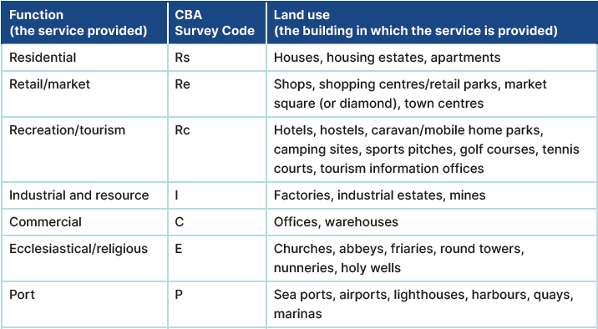
20.4 Describe what is meant by ‘functions of nucleated settlement’.

Slide 42
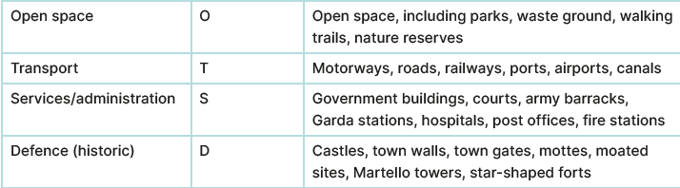
20.4 Describe what is meant by ‘functions of nucleated settlement’.

Slide 43
20.4 Describe what is meant by ‘functions of nucleated settlement’.
Complete the Exam Expert on page 249 of your Textbook.

Slide 44

The learning outcome for this topic requires you to ‘consider the factors affecting the location and origin of rural and urban settlement in Ireland’.
There is a CBA2 Warm-Up on pages 252–254 of your Textbook. This CBA Warm-Up helps you examine the origins and development of your local town.
Follow your teacher’s advice. It may not be possible or suitable for this – or another CBA 2 might be more suited to your class and school.

Slide 45
20.4 Describe what is meant by ‘functions of nucleated settlement’.
Go to Section 20.4 on page 110 of your Skills Book.

Slide 46
Assess your progress
Go to page 111 of your Skills Book and assess your progress.
20.1 Describe the different types of settlement in Ireland through time.
20.2 Describe and explain the different types of rural settlement patterns.
20.3 Explain the factors affecting the location of nucleated settlement.
20.4 Describe what is meant by ‘functions of nucleated settlement’.
Identify any gaps in your learning. Use the Rapid Revision on page 255 of your Textbook to jog your memory.

